Slide 1
Introduction to Markov State Models
Drug Computing — Mobley Lab — UCI

Slide 2
Markov processes describe the dynamics of systems that have no “long term memory”
Flipping a coin
0.5
0.5
0.5
H
T
Michaelis-Mentin Kinetics
0.5
E + S
k_{f}
ES
k_{r}
k_{cat}
Where the system goes next is completely determined by where it currently is, and not where it was in the past
E + P

Slide 3
Markov State Models (MSMs) reveal kinetics of configurational transitions
Highly Disordered Trajectory
Step 1
Step 2
Step 3
Step 4
Step 5
Step 6
Step7
…
2 fs
12 fs
Markov State Model (MSM)
1
3
2
4
5
6
7

Slide 4
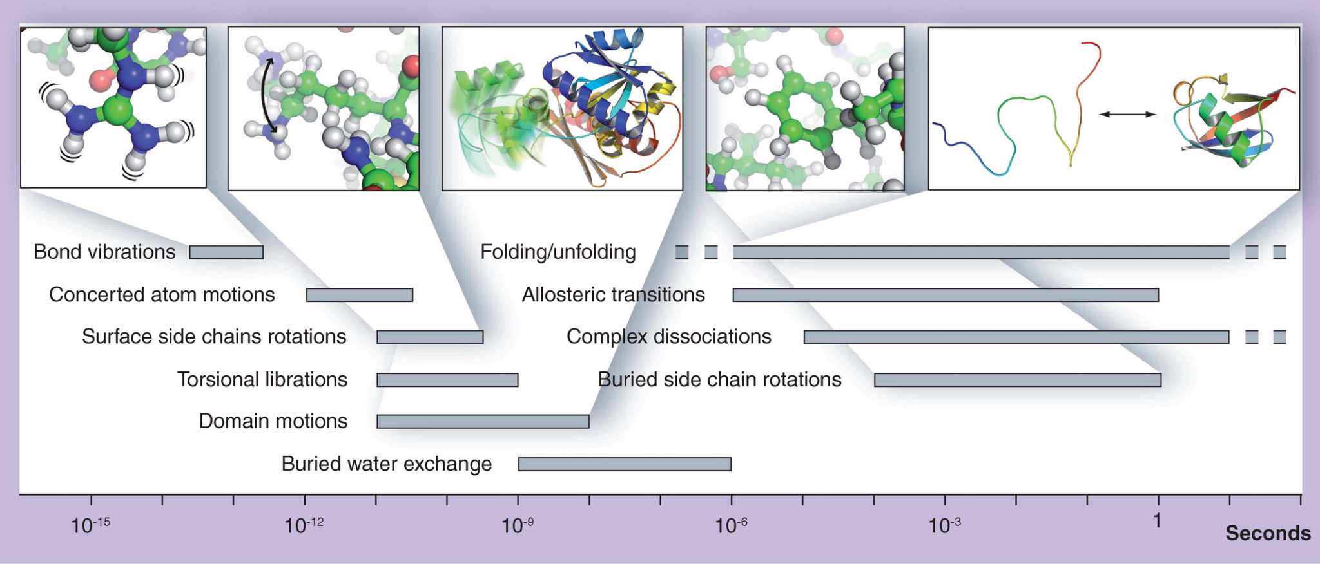
MSMs can be used to capture the macrostates of protein dynamics
fs
ns
ms
Future medicinal chemistry 3.16 (2011): 2079-2100.

Slide 5
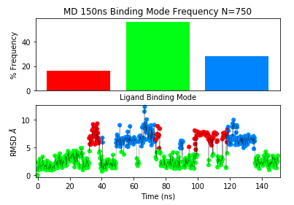
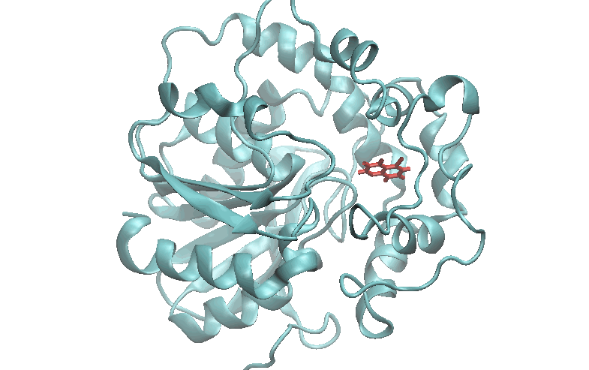
Markov State Models (MSMs) reveal kinetics of configurational transitions
Notes:
Molecular Dynamics trajectories have no “memory” in that every frame only depends on the state of the previous frame

Slide 6
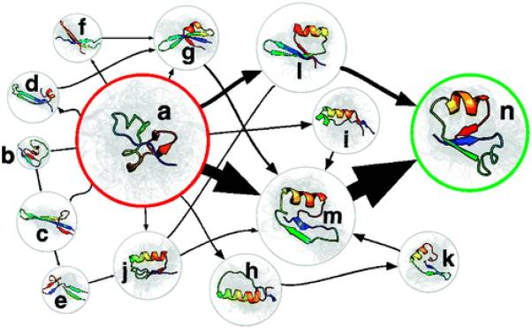
Building a Markov State Model
Useful for combining many different simulations into a single model
Example: building a (long timescale) kinetic protein folding pathway
JACS 132.5 (2010): 1526-8

Slide 7
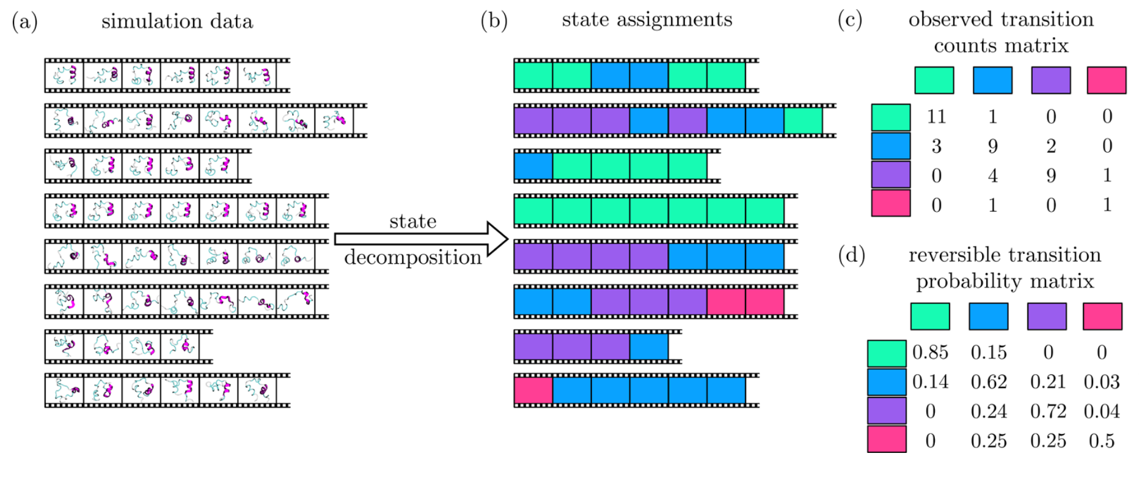
MSMs can be built from many short simulations
JACS 140.7 (2018): 2386-2396.
Notes:
Molecular Dynamics trajectories have no “memory” in that every frame only depends on the state of the previous frame

Slide 8
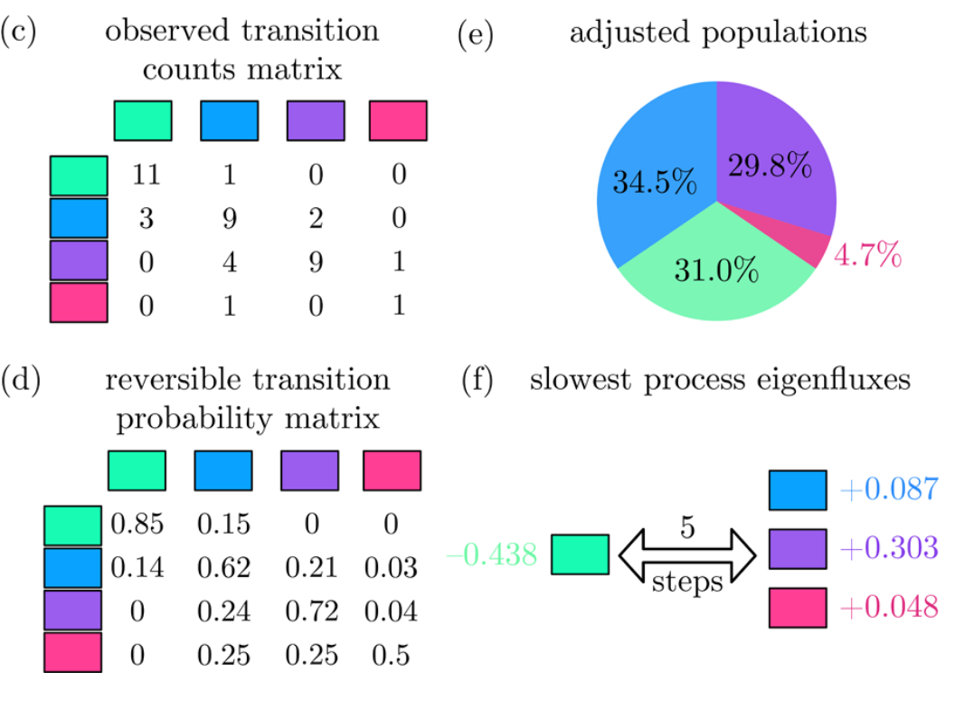
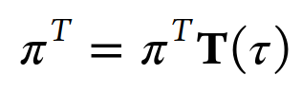
MSMs can describe the equilibrium process of the model
First eigenvector of the probability matrix describes the equilibrium populations
Other eigenvectors (processes) show fluxes between states
JACS 140.7 (2018): 2386-2396.

Slide 9




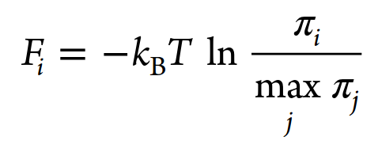
Building a Markov State Model
Free Energy
Closed
Open
Open
Configuration Space
Closed

Slide 10
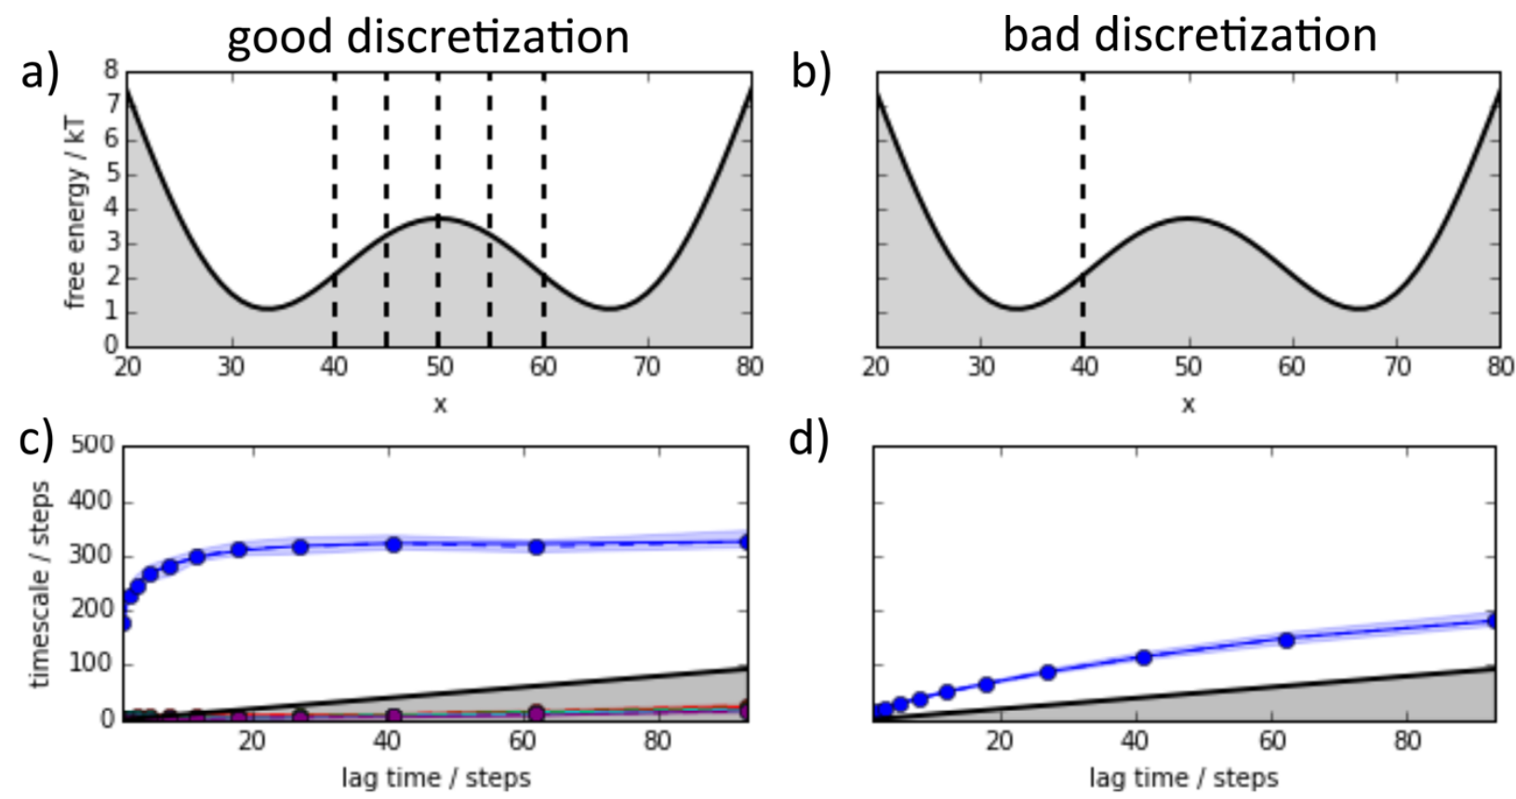
Good clustering is necessary for maintaining Markovian properties
JCTC 11.11 (2015): 5525-5542.

Slide 11
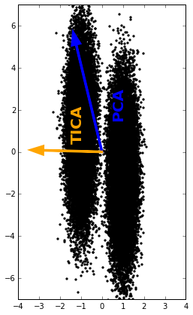
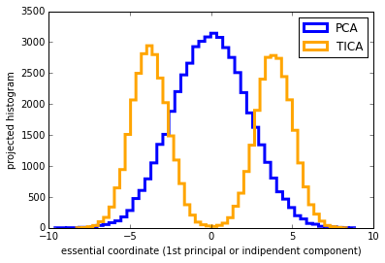
Dimensionality Reduction:
Principle Component Analysis (PCA) and
Time-independent Component Analysis (TICA)
PCA finds the direction of
maximum variance in the data
TICA identifies the slowest
reaction coordinates (maximum autocorrelation)
Projection:
http://docs.markovmodel.org/lecture_tica.html
Notes:
If we generated a trajectory for particles moving around in this double-well, the direction of maximum variance would be in the direction of the first PC, but the direction of maximum autocorrelation would be in the direction of the first TICA coordinate

Slide 12
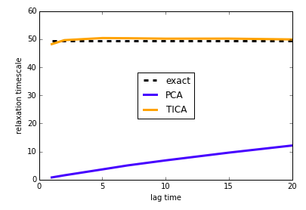
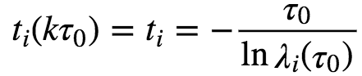
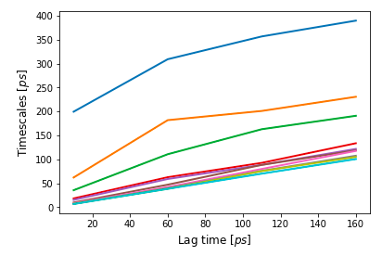
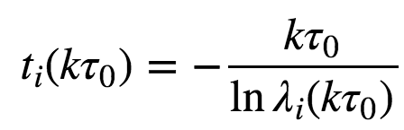
Testing the dimensionality reduction: Implied Timescales
Perfectly Markovian Process
http://docs.markovmodel.org/lecture_implied_timescales.html
Imperfect Markov Model
Choose a time scale at which the model
appears to start behaving Markovian
Notes:
Implied relaxation timescales should be independent of lag-time for a perfect Markov Model

Slide 13

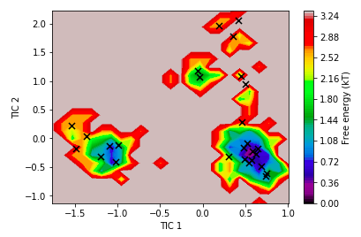
Using the dimension reduction to identify macrostates of the system
PCCA and K-means Clustering
K-means Clustering:
Identifies clusters based on distance in TICA space

Slide 14
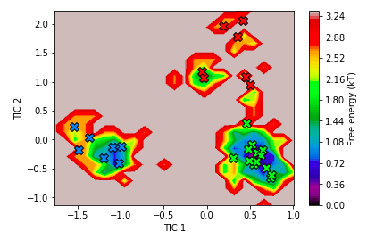
Using the dimension reduction to identify macrostates of the system
PCCA and K-means Clustering
PCCA: Perron-Cluster Cluster Analysis
Uses the eigenvector-eigenvalue decomposition to identify meta-stable states
Splits the available conformational state space in order of longest relaxation time

Slide 15
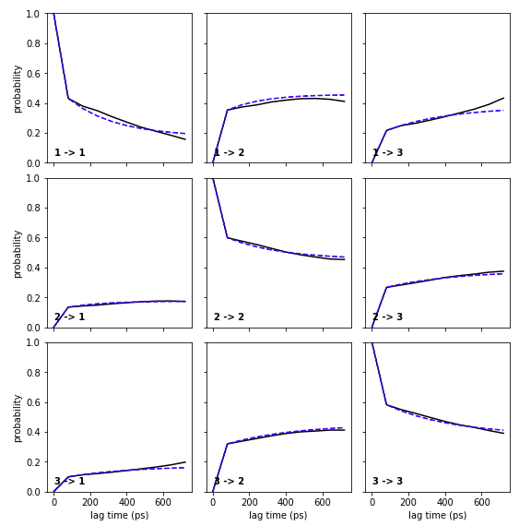
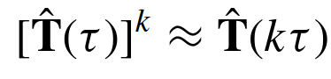
Testing the Markov Model:
Chapman-Kolmogorov test
How well do the
interconversions
between the
coarse-grained
macro-states
of the model
compare to the
real trajectory?

Slide 16
Core concepts and procedure to use Markov models
(1) Identify Configuration Microstates
Dimensionality Reduction
TICA, PCA
Clustering
K-means
(2) Construct Transition Matrix Between States
(3) Test for Self-Consistency
(4) Calculate Kinetics + Free Energy Between States

